Slide 1
What SCILT can do for you…
…a brief overview of our Outreach activities 2012/13

Slide 2
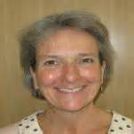
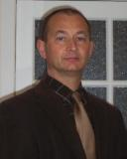
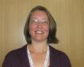
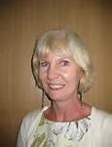
The Outreach Team
Christian Baert
Meryl James
Janette Kelso
Lynne Jones

Slide 3
Our Workshops
A menu of 20 professional learning workshops for primary, secondary and ASN practitioners
Informed by current educational research
Focussed on positive impact on learners
Exemplified by examples of good practice
Opportunities for professional dialogue
Pre-event reading/viewing
Support for taking it further

Slide 4
Our engagement…
35 different Outreach events and 4 Glow meets
6 promotional visits to schools
25 local authorities and one event for independent schools
A further 3 LAs reached via Glow meet
Engagement with approximately 864 teachers

Slide 5
This year’s most popular…
Bringing French to Life through an Interdisciplinary journey
Gathering Evidence and Reporting
Planning from the Broad, General Education into the senior phase

Slide 6
Next Year’s menu – can you help us?
What are your priorities for next session?
What are your Professional Learning needs?
How best can we reach the profession?
What are the barriers and how can we overcome them?
What can we do to best support the ML community?

